Slide 1
ZS Campus Beats 2021 Case Challenge

Slide 2
Scenario two (BUSINESS OPERATIONS)

Slide 3
Calculate quarter earnings for each representative
Background
Pulse Beverages compensates its Sales Managers with bonuses, based on their sales performance for each quarter
The quarterly bonus is based on the Attainment where Attainment is defined as the sales volume achieved on the goals.
As Aqua Orange is available in different bottle sizes.
The goals are set for 500ml as Standard unit.
Attainment | Payout
0% | 0%
49.90% | 0%
50% | 10%
70% | 20%
80% | 40%
90% | 65%
100% | 100%
150% | 230%
200% | 280%
225% | 190%
250% | 290%
275% | 313%
500% | 433%
750% | 433%
1000% | 433%

Slide 4
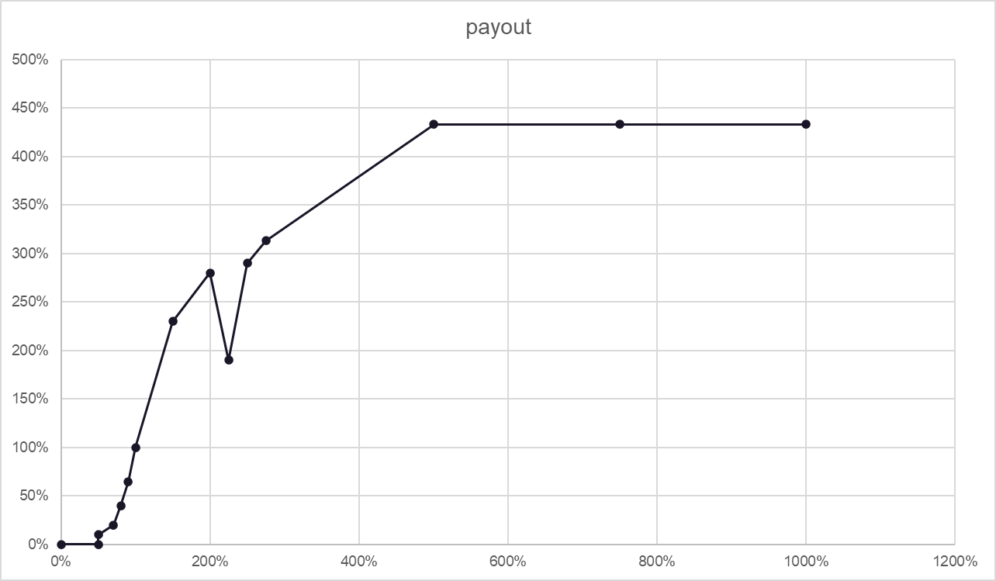
PROBLEM STATEMENT
Q.1..1) Plot a straight line curve for the payout curve using the inflection points provided in Table A

Slide 5
Q.1.2) Calculate bonus for each sales manager for Q3’20 based on the sales and goals provided.
Manager ID | Sales Manager | 2019 Q4 | 2020 Q1 | 2020 Q2 | Average | Goals - Q3 2020 | Attainment | BONUS % | BONUS PAID
10011 | Rakesh S | 7526.5 | 16809 | 100360 | 41565.17 | 170000.00 | 44% | 0 | 0
10015 | Rahul S | 11744.5 | 33314 | 957165 | 334074.50 | 235000.00 | 407% | 383.30% | 3833000
10019 | Kirti S | 14534 | 31192 | 180405 | 75377.00 | 160000.00 | 112.75% | 133.15% | 1331500
10017 | Vishwa P | 20783 | 31765.5 | 179125 | 77224.50 | 190000.00 | 94.27% | 79.96% | 799600
10012 | Kalpana K | 11664.5 | 23003.5 | 182280 | 72316.00 | 200000.00 | 91% | 65% | 650000
10013 | Ram S | 14902.5 | 29748 | 196635 | 80428.50 | 225000.00 | 87.33% | 57.50% | 575000
10016 | Kirti S | 12475.5 | 25106.5 | 125150 | 54244.00 | 145000.00 | 86.31% | 56% | 560000
10014 | Taran S | 11229.5 | 24263 | 137595 | 57695.83 | 170000.00 | 80% | 40% | 400000
10020 | Abhishek S | 13188 | 118612.5 | 170650 | 100816.83 | 250000.00 | 68% | 19.13% | 191300
10018 | Ankit J | 7627.5 | 19946.5 | 98530 | 42034.67 | 180000.00 | 54.73% | 12.36% | 123600
Which Sales manager have the highest payout?
Rahul S (Manager Id - 10015)
b)What is the total payout of bottom three sales managers?
Abhishek S, Ankit J and Rakesh S received the total payout of Rs.314900
Q.1.3) What would be the total spend of the company for incentives for Q3’20?
Rs.8464000

Slide 6
Assess the current methodology for performance evaluation and identify the reasons for Sales Manager’s concerns
Background
The goal process is very subjective and has resulted in dissatisfaction among the Sales Manager.
ZS decides to look at the historical data and identify reasons for Sales Manager concerns

Slide 7
PROBLEM STATEMENT
Q.2.1)What are your observations related to previous two quarters? How does it relate to the bonus calculated in part 1 ?
Due to COVID19 situation PAN India, our sales have declined which as affected the incentives of Sales Executives but with ease in restrictions, markets are opening and recovery in sales number have been observed.
Q.2.2) What mathematical formula/approach would you suggest to set targets for the sales manager if Pulse Beverages is able to provide a national forecast of Sales for the Nation. What are the pros and cons of the scene ?
We would be suggesting Break-even Point approach to set targets for the sales manager.
PROS
- We would be able to meet the target with no loss and with all the money invested in product.
- This is a cautious approach as in this pandemic, markets are deviating from their natural behaviour.
CONS
- It would also result in less profits as it is a preventive measure to take care of losses
- There will be no inclination in the number of sales. We have to consider production and sales as equal.

Slide 8
Q.1.3) It is observed that only 85% of the sales data is captured for Chennai for Q3’20. What would be the updated Q3’20 payout for the Sales Manager for Chennai ?
The updated Q3’20 payout for the Sales Manager for Chennai is 175000.

Slide 9
Communicating Performance
Background
To maintain transparency related to performance , the Sales Leadership has reached out to ZS to design a monthly scorecard that would be share with the Sales Manager to communicate the monthly performance

Slide 10
PROBLEM STATEMENT
Q.3.1) Develop the format of a performance report which can be handed out to the Sales manager at the end of every month to communicate the performance. What key fields would the report include ?
The format of performance report should be on the basis of :
The number of bottles of each size sold.
In the presence of a product mix , each product must be sold or it may lead to the discontinuity of one.
Each product would add to the earnings and profits of the company differently and performance must be judged on the basis of equitable products sold.
Performance should be evaluated on a weekly basis for a broader evaluation and consistency of the Sales manager.
Evaluation on the basis of variety of clients and business development.
Q.3.2) What quality checks would you perform on the data provided for Part 1 to ensure the data is accurate?
Each product would add to the earnings and profits of the company differently and performance must be judged on the basis of equitable products sold.
Operations should be diversified into sub-regions as conventional way of doing this in taking one region as a whole creates chaos and mismanagement.
There should be a check from the sides of Wholesalers too.

Slide 11
Q.3.3) The Sales Leadership was planning to go away from goal-based plan and come to rank-based plan based on growth in sales as compared to baseline period. Would it be fair? What modification would you propose to this approach ?
The convention goal based plan must be continued to applied. A rank based plan based on growth in sales might be unfair to the sales manager. Each sales manager works in a different city with different environments, climates and cultures. There is also a vast majority in the number of clients in different cities. Goals provided to the sales managers are in lieu of all the above factors.
It would be unfair to rank the sales managers and it may lead to a negative work environment fueled by unhealthy competition.

Slide 12
OBJECTIVE QUESTIONS
Which Sales Manager has the highest payout ?
Rahul S
What is the total payout of the bottom 3 Sales Manager ?
Abhishek S, Ankit J and Rakesh S received the total payout of Rs.314900
What would be the total spend of the company for incentives for Q3’2020 ?
Rs.8464000
What would be the updated Q3’20 payout for the Sales Manager for Chennai?
The updated payout for the Sales Manager for Chennai is 175000.

